Slide 2
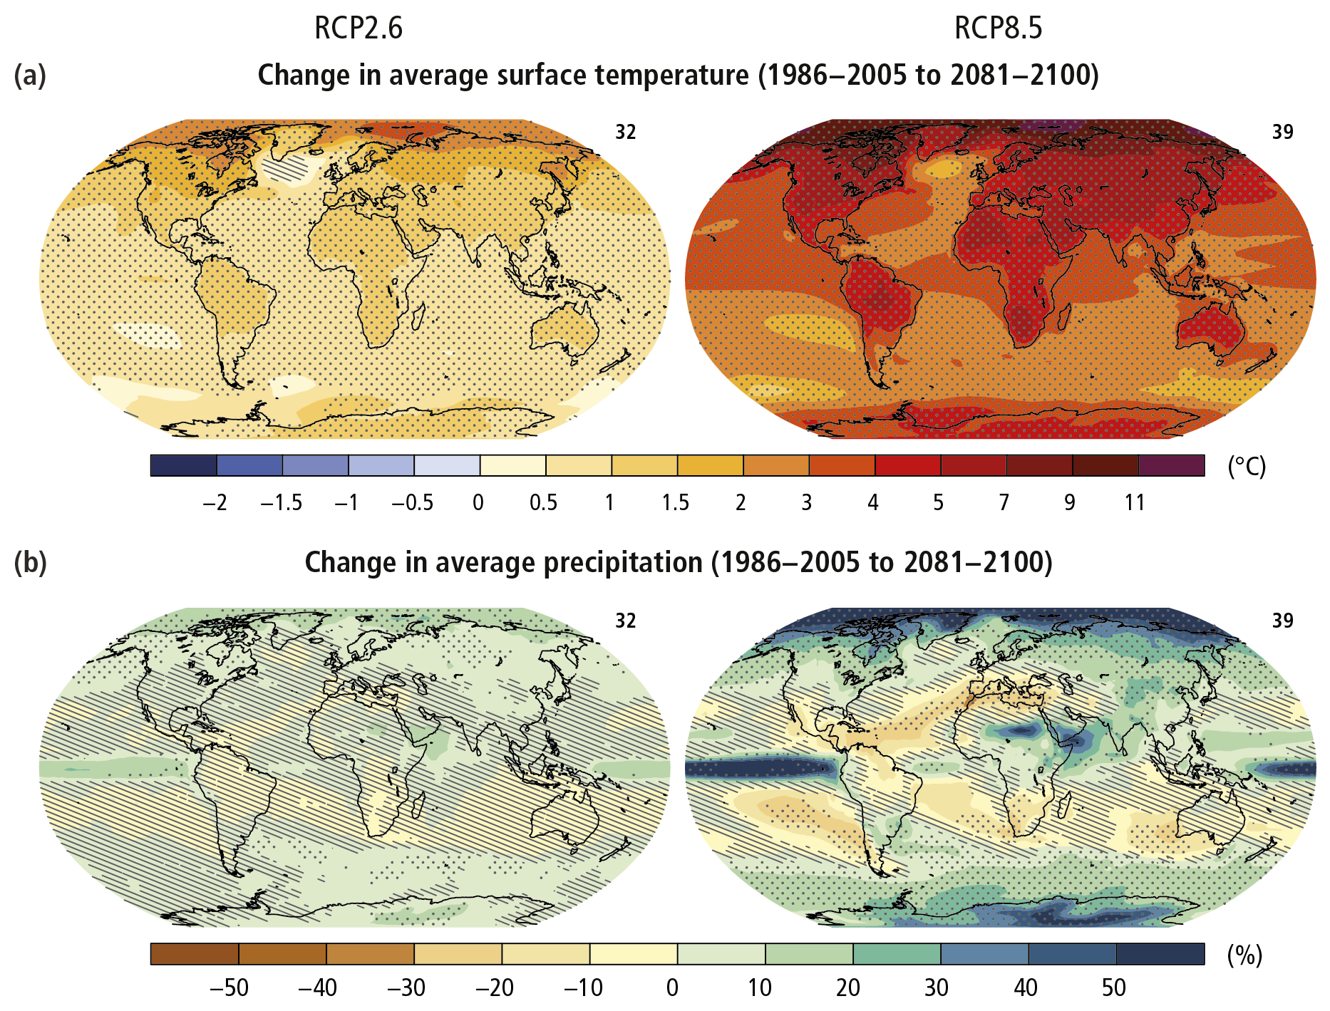
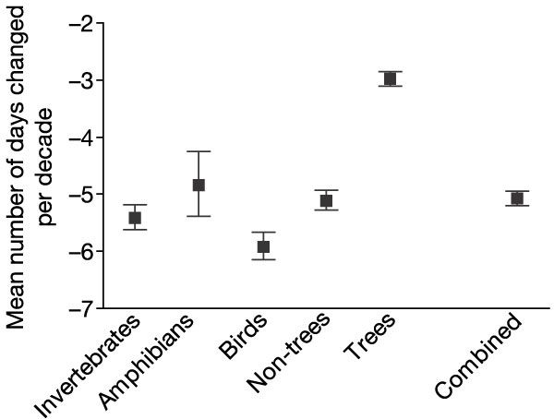
Climate Change and Phenology

Slide 3
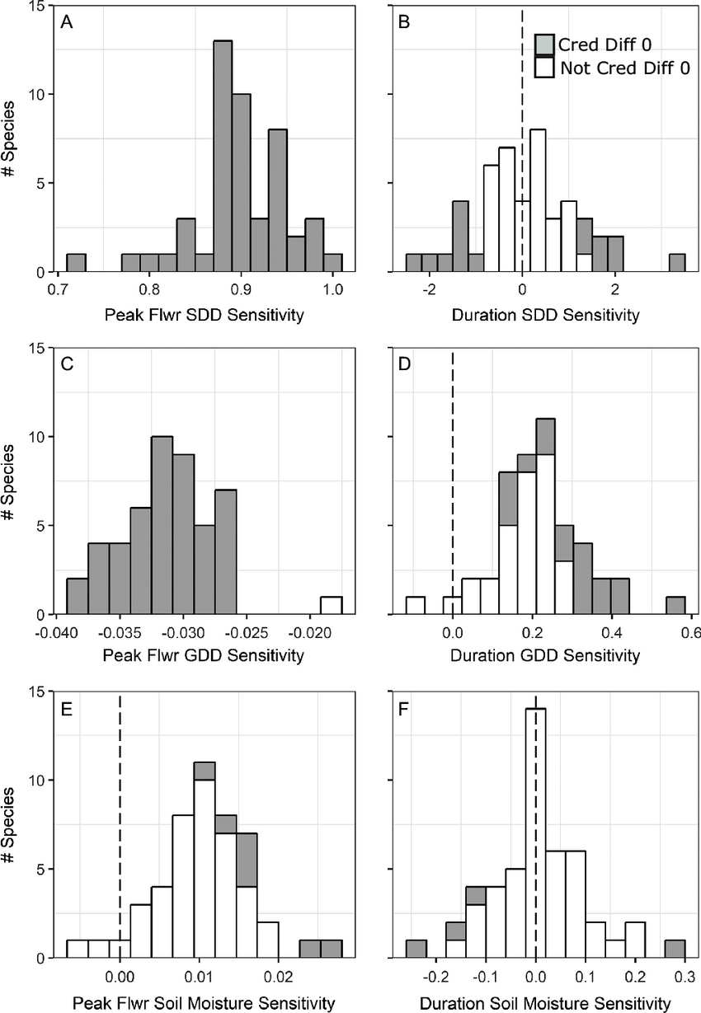
Phenological sensitivity
The shift in phenological event date per degree of temperature change

Slide 4
How does differential phenological sensitivity mediate plant interactions?

Slide 5
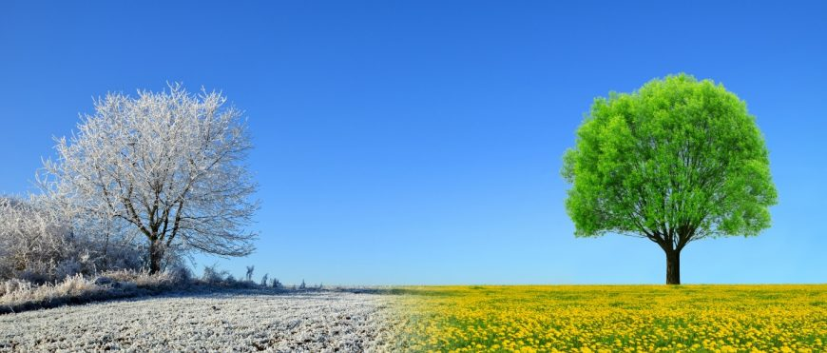
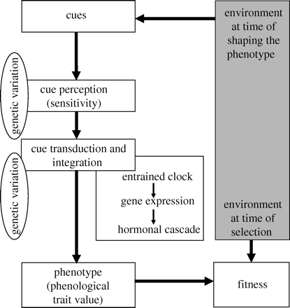
Phenological transition: dormancy to growth
Insert picture of bud and seed here
Optimum
Openworksweb.com
Visser 2010

Slide 6
Research Overview

Slide 7
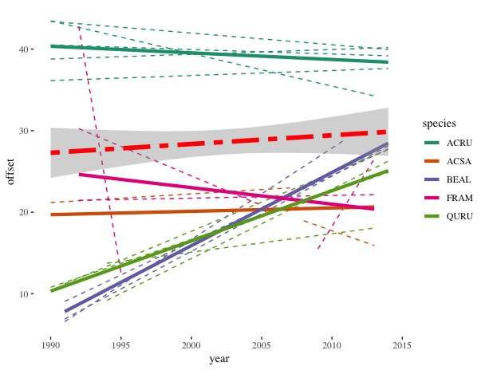
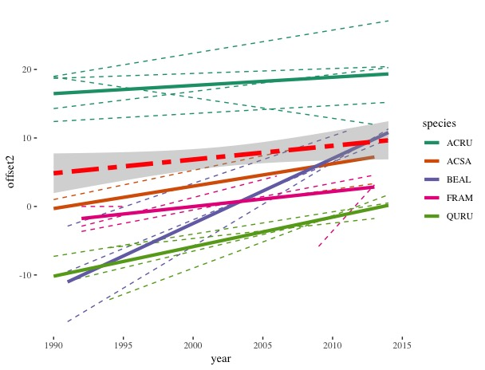
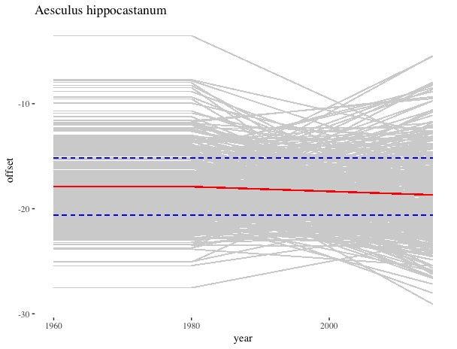
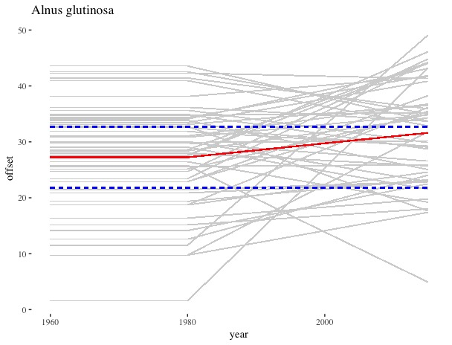
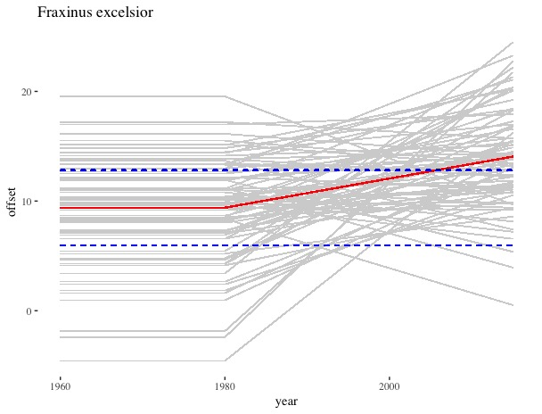
Background
Why do some temperate species flower before leafing out while others leaf first?
Notes:
1: l75 and fopn, 2 fbb and lbb,

Slide 8
Background
Hypotheses:
Wind pollination efficiency
Water relations*
Extreme early flowering
Phylogenetic constraint
Data limitation(s):
Limited quantitative data
Uncertainty in categorical data*
Research Questions:
Q1:
Q2:
Notes:
* I’ll talk more about this

Slide 9
Methods

Slide 10
What does “flowers before leaves” really mean?
Sources of Uncertainty:
Observer
Geographic
Temporal
Modeling choices

Slide 11
Preliminary results
MTSV | D | USFS | D
Physiological | 0.29 | Physiological | 0.12
Intermediate | 0.16 | Intermediate | 0.11
Functional | 0.05 | Functional | 0.64

Slide 12
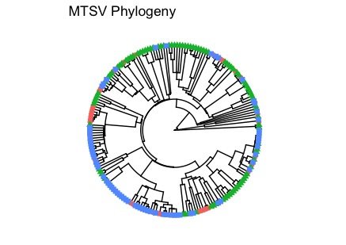
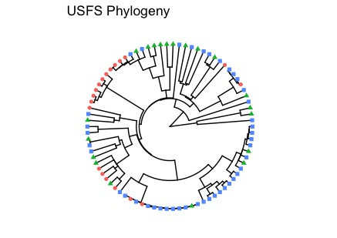
Preliminary results
Notes:
Red always hyst. Green, always ser. Bue tramsopmtopma;

Slide 13
Preliminary results
Suggesting:
Pollination syndrome, shade tolerance and early flowering associated with hysteranthous FLS
Upshot:
Quantitative data buffers against modeling choices, yeilding more stable predictions
Analysis will improve as more quantitative data are collected and become available (citizen science, long term monitoring)
Notes:
Red always hyst. Green, always ser. Transitions with recatagorization

Slide 14
Background and Question
Part I

Slide 15
Hypotheses:
Part II

Slide 16
Methods
Part I

Slide 17
Current status

Slide 18
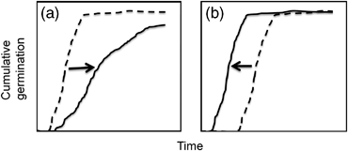
Background and questions
Walck 2011
Notes:
Shifts of germination phenology between now (dashed lines) and the future (solid lines) with global warming for species requiring cold stratification. (a) Seedling emergence will be delayed if the current length of cold stratification approximates the minimum requirement. In this case, shortened winters will not adequately overcome dormancy and seeds will require increased time in spring to germinate. (b) Emergence will be earlier if the current length of stratification greatly exceeds the minimum required. Seeds remain un‐germinated (but nondormant) until spring temperatures warm, and thus shortened winters do not affect dormancy break but premature spring warm‐up accelerates germination.

Slide 19
Background and questions
Notes:
Thermal time equation: not grerat with doormancny

Slide 20
Background and Questions
Stratification in the model, drop in Tb
Notes:
Mathmaically and biological good

Slide 21
Methods
Show pictures of chambers here

Slide 22
Methods
Thermal time model
Calculation of Tb
Evaluation of sensativity of Tb
Phenological reassembly?

Slide 23
Project status
Show figure

Slide 24
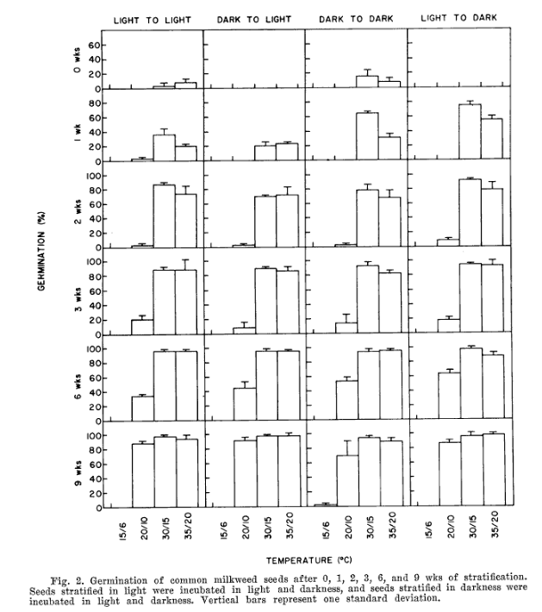
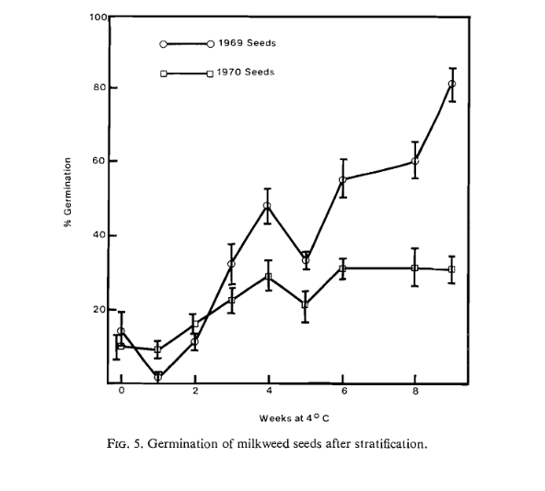
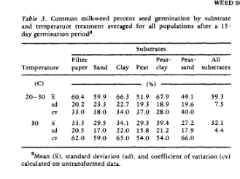
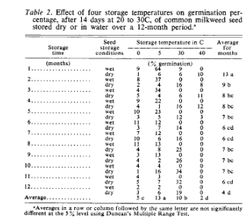
Background: OEGREs
Notes:
Evetts 1972
Oegema and Fletcher 1972
Farmer 1986
Baskin and Baskin 1977
Add picture of Ascleptias only

Slide 25
Questions:
Notes:
Map of eastern US to global map with points all over the world

Slide 26
Methods

Slide 27
Project Status

Slide 28
Seasonal Priority Effects

Slide 29
Seasonal Priority Effects

